Slide 1
Sustainable Energy Team# 3 CSCN8010 – Foundation of Machine Learning
Team members:
Kapil Bhardwaj
Parag Shah
Preetpal Singh

Slide 2
About our Project
As AI models become more powerful, they also become more resource-hungry.
There is a growing need to measure, reduce, and report energy consumption related to AI model usage, especially large language models (LLMs).
This project introduces a machine learning and NLP-powered solution for:
Energy prediction of prompt executions
Prompt optimization to reduce compute requirements
Transparency and logging for green AI reporting
“AI cannot be sustainable if we cannot measure its energy.”

Slide 3
🌎 Sustainability Challenges of AI at Scale
🏢 Over 1,200 hyperscale AI data centers deployed globally in 2025
⚡ Projected to surpass the national electricity demand of Poland by next year
💦 2 million liters/day: Water consumed by a single 100 MW data center
💰 Annual health and environmental costs could reach $9.2 billion
Global regulatory push:
California’s Zero-Carbon Mandates (SB 57, AB 222) – for tech companies
EU AI Act: Mandatory energy disclosure by August 2026
India's draft digital emissions guidelines (2025)
Why Our Project Matters
No real-time way to measure AI prompt energy cost
Developers & researchers have zero feedback loop to improve
Climate regulators need transparent prediction tools
Our Impact
We’re building a prediction engine + recommender system to:
Estimate energy usage for any prompt
Flag inefficient queries & possible prompt attacks
Suggest greener alternatives with minimal accuracy loss

Slide 4
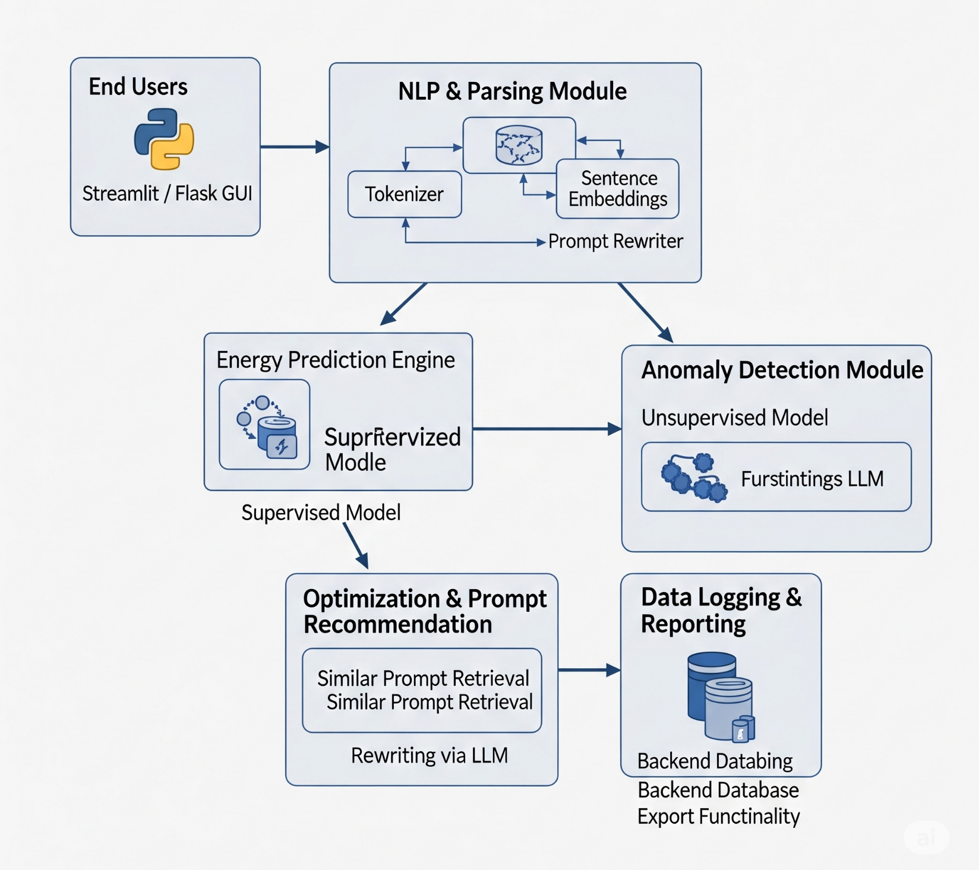
Architecture Diagram

Slide 5
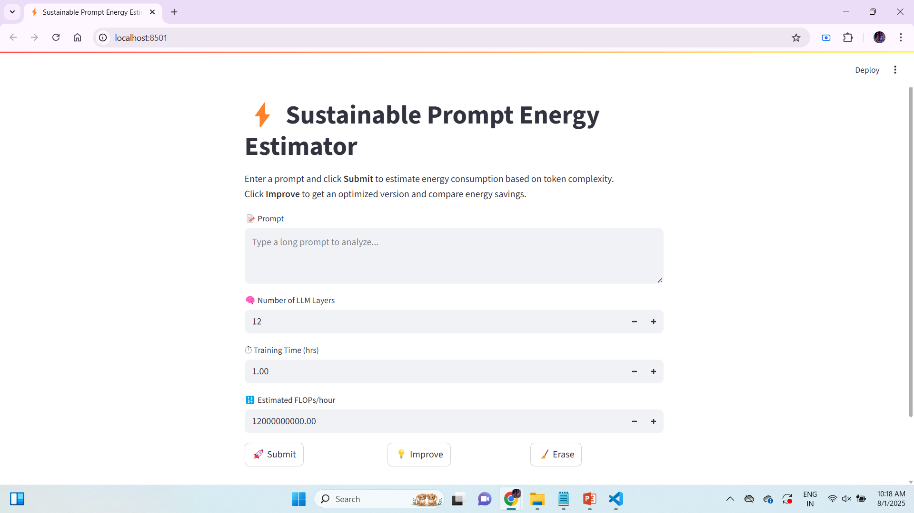

Slide 6
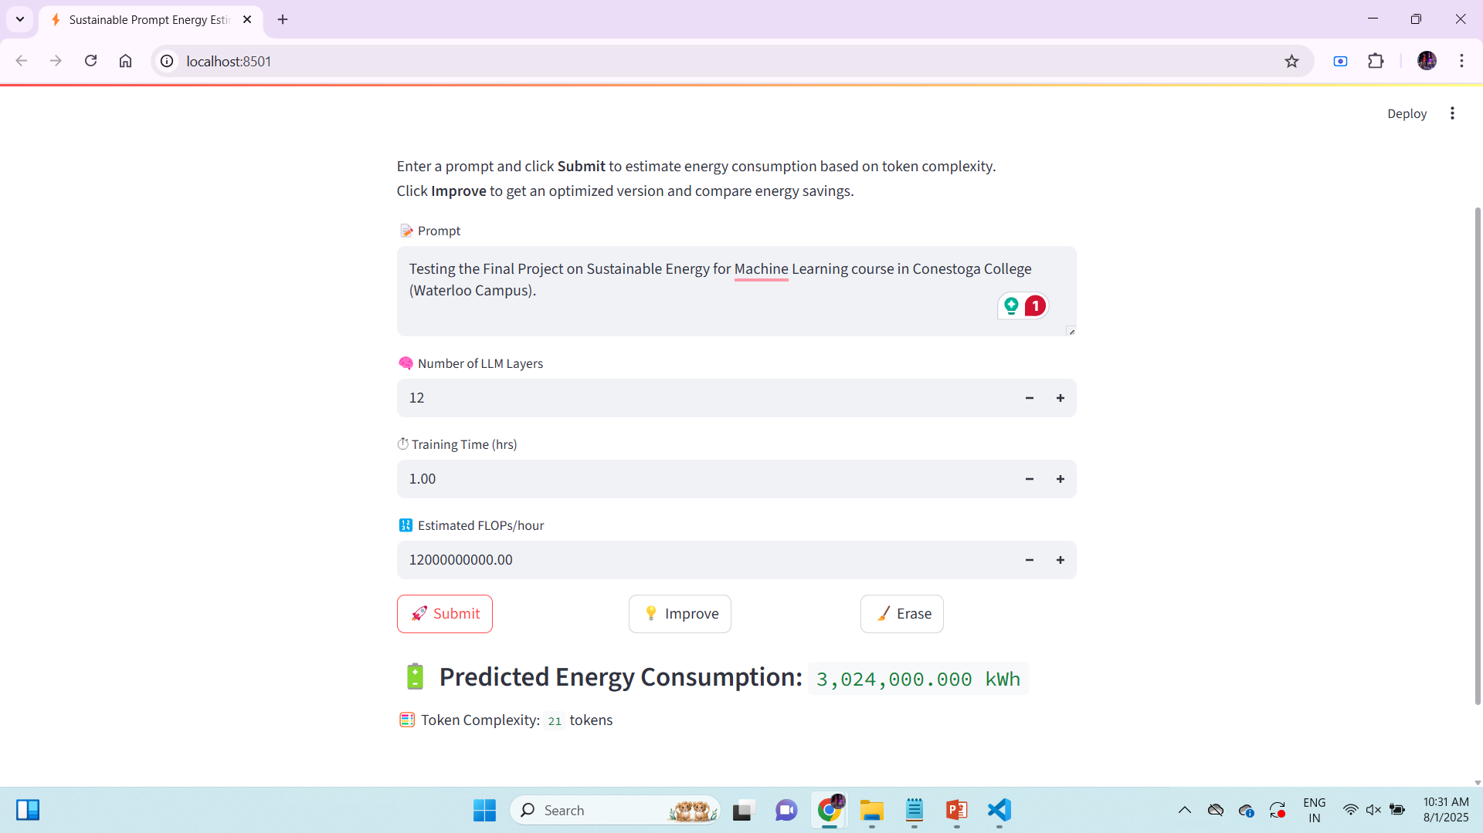
Result for predicted energy Consumption

Slide 7

Result after Improve predicted energy Consumption

Slide 8
Any Suggestions?

